Slide 1
The Obstetric Impact of Grand Multiparity
Dr. Sawsan Al-Obaidly
Consultant, Maternal-Fetal Medicine
Obstetrics and Gynecology Department
Women’s Hospital
Hamad Medical Corporation
Doha-Qatar

Slide 2
Disclosures
None

Slide 3
Objectives
Grand multiparity. The incentives!
Definition
Relationship between parity and pregnancy outcome
Previous Cesarean section in GP
TOLAC and GP
Long term outcome
Patient counselling and summary

Slide 4
Abrahamic religions-Islam
قال الله تعالى: الْمَالُ وَالْبَنُونَ زِينَةُ الْحَيَاةِ الدُّنْيَا
{الكهف:46}
Wealth and children are [but] adornment of the worldly life.
{al kahf 46}
جاء في الحديث الشريف عن النبي - صلَّى الله عليه وسلَّم -: ((تزوَّجوا الودودَ الولود؛ فإني مكاثِر بكم الأممَ يومَ القيامة))
“Marry the one who is fertile and affectionate, for verily I will be proud of your great number before (other) nations on the Day of Judgment. (Mohammed PBUH)

Slide 5
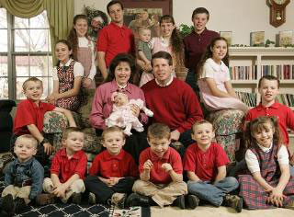
Abrahamic religions-Christianity
“Behold, children are a gift from the Lord; The fruit of the womb is a reward. Like arrows in the hand of a warrior, So are the children of ones youth. How blessed is the man whose quiver is full of them; They shall not be ashamed when they speak with their enemies in the gate”
Psalms 127:3-5
“Your wife shall be like a fruitful vine Within your house, Your children like olive plants Around your table”
Psalm 128:3

Slide 6
Abrahamic religions-Judaism
When Jacob entered the land of Israel, G‑d repeated it to him: "And G‑d said to him, 'I am the Almighty G‑d; Be Fruitful and Multiply..."
Talmud, Yevamot 65b
Genesis 1:28

Slide 7
History
The greatest officially recorded number of children born to one mother is 69, to the wife of Feodor Vassilyev (b. 1707–c.1782), a peasant from Shuya, Russia. In 27 confinements she gave birth to 16 pairs of twins, seven sets of triplets and four sets of quadruplets.
The Guinness book of world records, 1998
Notes:
http://www.guinnessworldrecords.com/world-records/most-prolific-mother-ever

Slide 8
Definition
≥5 live births and stillbirths ≥20 weeks of gestation.
great grand multiparity defined as ≥10 live births and stillbirths ≥20 weeks of gestation
Abu-Heija AT et al J Obstet Gynaecol 1998

Slide 9
Relationship Between Parity and Pregnancy Outcome
Several studies
Inconsistent findings of relationship between obstetric complications and parity
Limitations of observational data.
Several reasons for the discordancy
Notes:
The relationship between obstetric complications and parity has been studied extensively, with inconsistent findings. In addition to the usual limitations of observational data, there are several reasons for the discordancy:

Slide 10
Parity
Grand multiparity
Controls
Nonlinear relationship
Maternal age
Healthy person effect
Notes:
Several reasons for the discordancy:
Variability in the definition of parity
Variably defined grand multiparity
Variability in the definition of controls
Nonlinear relationship between parity and pregnancy outcome
Inadequate adjustment for maternal age
Healthy person effect

Slide 11
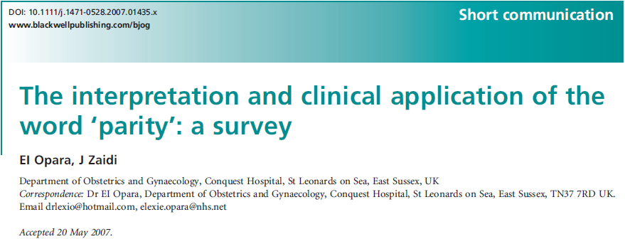
Evaluate the definition of parity among obstetricians and midwives in London
126 questionnaires
62 % defined parity as pregnancies ≥24 weeks of gestation irrespective of outcome,
25 % defined parity as pregnancies ≥24 weeks ending in live birth, and
13% defined parity by the number of pregnancies irrespective of outcome.
Only 21% of those surveyed described twin pregnancies as a single parous experience.
Opara, E. et al, BJOG 2007
Notes:
Variability in the definition of parity — There are discrepancies in the way clinicians define parity. A study that evaluated the definition of parity among obstetricians and midwives in London noted that 62 percent defined parity as pregnancies ≥24 weeks of gestation irrespective of outcome, 25 percent defined parity as pregnancies ≥24 weeks ending in live birth, and 13 percent defined parity by the number of pregnancies irrespective of outcome [5]. Only 21 percent of those surveyed described twin pregnancies as a single parous experience.

Slide 12
Variably defined grand multiparity
Investigators have variably defined grand multiparity as a parity of four, five, six, seven, or eight.
Aliyu MH et al, Birth 2005
Notes:
variably defined grand multiparity: Finally, investigators have variably defined grand multiparity as a parity of four, five, six, seven, or eight. Thus, one study may report outcomes for women para ≥6 compared with those <6, while another reports outcomes for women para ≥5 compared with those <5 [7]

Slide 13
Variability in the definition of controls
Studies have compared grand multiparas to different referent groups, including women of parity 1, 1 to 3, 2 to 3, 2 to 4, 1 to 4, 1 to 6, 2 to 6, and the general obstetrical population.
This makes it difficult to compare findings among studies.
Bai J et al, J Obstet Gynecol 2002
Simonsen SM et al, Obstet Gynecol 2005
Bugg GJ et al, BJOG 2002
Roman H et al, Obstet Gynecol 2004
Toohey JS et al, Am J Obstet Gynecol 1995
Babinszki A et al, Am J Obstet Gynecol 1999
Notes:
Bai J et al, J Obstet Gynecol 2002
USimonsen SM et al, Obstet Gynecol 2005
Lyrenäs S et al, Gynecol Obstet Invest 2002
Bugg GJ et al, BJOG 2002
Roman H et al, Obstet Gynecol 2004
Toohey JS et al, Am J Obstet Gynecol 1995
Babinszki A et al, Am J Obstet Gynecol 1999

Slide 14
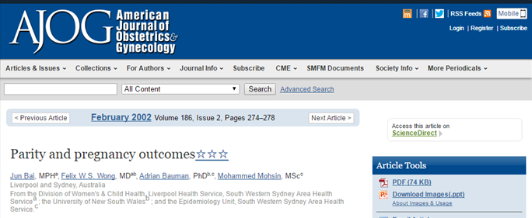
Cross-sectional analysis of births to women of parity 0 to 8 in Australia between 1992 and 1997,
multivariate analysis showed that the risk of pregnancy complications was highest in nulliparas, lowest in multiparas who had 1 to 3 deliveries, and intermediate in multiparas with ≥4 deliveries (for any obstetric complication: nulliparas OR 1.75, Para 1 to 3 OR 0.96-1.03, Para 4 to 8 OR 1.19-1.35).
These findings suggest that the risk in obstetric complications associated with parity is bimodal.
Bai J et al, Am J Obstet Gynecol 2002
Notes:
Nonlinear relationship between parity and pregnancy outcome — The relationship between parity and birth outcome is not linear. In a cross-sectional analysis of births to women of parity 0 to 8 in Australia between 1992 and 1997, multivariate analysis showed that the risk of pregnancy complications was highest in nulliparas, lowest in multiparas who had one to three deliveries, and intermediate in multiparas with four or more deliveries (for any obstetric complication: nulliparas OR 1.75, Para 1 to 3 OR 0.96-1.03, Para 4 to 8 OR 1.19-1.35) [8]. These findings suggest that the risk in obstetric complications associated with parity is bimodal.

Slide 15
Risk of Pregnancy Complications
A multivariate analysis of parity and pregnancy outcome reported a significantly increased risk of "any obstetric complication" among women of parity 4, 5, 6, and 7 to 8 when compared with primiparas.
The obstetric complications included antepartum hemorrhage, gestational diabetes, pregnancy-induced hypertension, premature rupture of membranes, threatened premature labor, postpartum hemorrhage, and third-degree lacerations.
There was a variable relationship between parity and the individual components of the composite outcome.
Bai J et al. Am J Obstet Gynecol. 2002
Notes:
Bai J et al. Am J Obstet Gynecol. 2002
No pdf

Slide 16
Inadequate Adjustment For Maternal Age
Many of the complications that have been associated with grand multiparity have also been independently associated with advanced maternal age.
Increasing maternal age is associated with increasing prevalence of comorbidities, such as type 2 diabetes, hypertension, and obesity, which also increase the risk of adverse pregnancy outcome.
maternal age is an important confounder that must be accounted for to minimize bias in interpretation of results.
Chan BC et al. Int J Gynaecol Obstet 2008
Notes:
Chan BC et al. Int J Gynaecol Obstet. 2008

Slide 17
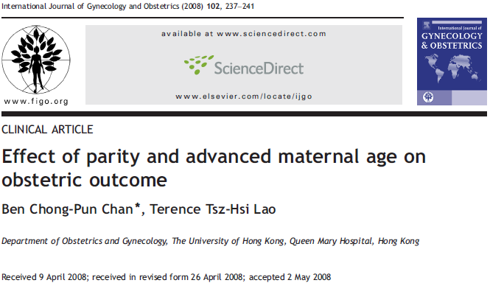
A retrospective cohort of 16 427 singleton pregnancies delivered between 1998 and 2001
was studied.
Obstetric outcomes in women aged ≥40 years versus women <40 years were compared for both nulliparous and multiparous women.
Results: Of the 15 727 pregnancies (95.7%) that satisfied the inclusion criteria, 606 (3.9%) were in women aged 40 years or older.
Advanced age was independently associated with cesarean delivery, birth and spontaneous
preterm labor before 37 weeks, and low birth weight neonates in nulliparous women, but only with preterm birth before 37 weeks and cesarean delivery in multiparous women.
Conclusion: Obstetric outcome in women aged 40 years or older was influenced by parity. Cesarean delivery and preterm birth before 37 weeks were independently associated with older age irrespective of parity. Advanced age is a risk factor for preterm birth.
Chan BC et al. Int J Gynaecol Obstet 2008
Notes:
Inadequate adjustment for maternal age — Many of the complications that have been associated with grand multiparity have also been independently associated with advanced maternal age [21]. Increasing maternal age is associated with increasing prevalence of comorbidities, such as type 2 diabetes, hypertension, and obesity, which also increase the risk of adverse pregnancy outcome. Thus, maternal age is an important confounder that must be accounted for to minimize bias in interpretation of results.
Limitation of the Chan study: They didn’t specify the number of parous women. But likely there were grand multiparity as this study was done in Hong Kong were the average is 2 children per couple.

Slide 18
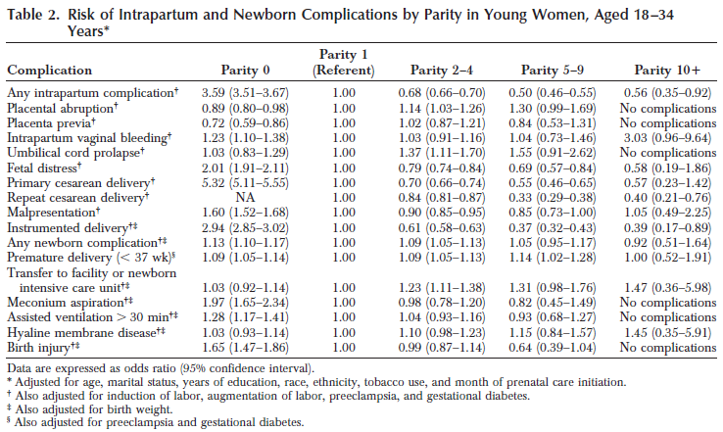
Young GM n= 4937
Young PM n= 83,000
Simonsen SM et al. Obstet Gynecol 2005
Notes:
The importance of maternal age was illustrated in a retrospective cohort study that examined the birth outcomes of 4937 young (under 35 years of age) grand multiparas (parity ≥5) and over 83,000 young primiparas in Utah. Young grand multiparas were at significantly lower risk for "any intrapartum complication" (eg, placental abruption, placenta previa, intrapartum vaginal bleeding, umbilical cord prolapse, fetal distress, malpresentation, surgical delivery, instrumented delivery) compared with young primiparas.
In addition, young grand multiparas were at significantly lower risk for any intrapartum complication when compared with older grand multiparas.

Slide 19
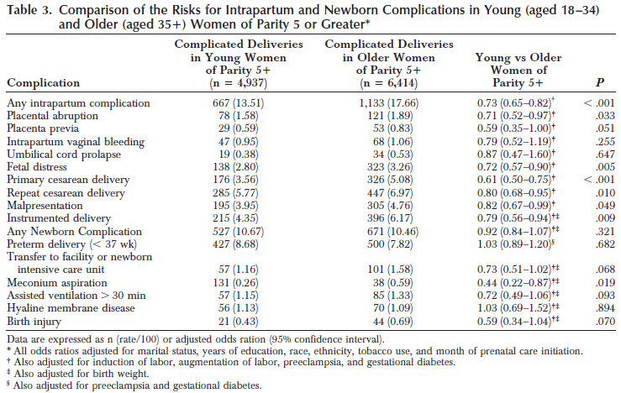
Simonsen SM et al. Obstet Gynecol 2005
Notes:
The importance of maternal age was illustrated in a retrospective cohort study that examined the birth outcomes of 4937 young (under 35 years of age) grand multiparas (parity ≥5) and over 83,000 young primiparas in Utah. Young grand multiparas were at significantly lower risk for "any intrapartum complication" (eg, placental abruption, placenta previa, intrapartum vaginal bleeding, umbilical cord prolapse, fetal distress, malpresentation, surgical delivery, instrumented delivery) compared with young primiparas.
In addition, young grand multiparas were at significantly lower risk for any intrapartum complication when compared with older grand multiparas.

Slide 20
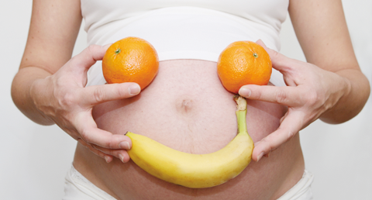
Healthy Person Effect
Women with previous obstetrical complications in their first few pregnancies may be more likely to end childbearing before becoming grand multiparas compared with women who had uncomplicated pregnancies and deliveries.
Grand multiparas may represent a healthier group than women of lower parity.

Slide 21
Grand multiparity probably increases the risk of the following complications, although findings are inconsistent across studies:
Placental abnormalities, such as placenta previa and abruption
Postpartum hemorrhage
Macrosomia
Umbilical cord prolapse
Alsammani MA et al, Mater Sociomed 2015
Roman H, Obstet Gynecol 2004
Lyrenäs S et al, Gynecol Obstet Invest 2002
Notes:
Choose largest series
Lyrenäs S et al, Gynecol Obstet Invest 2002

Slide 22
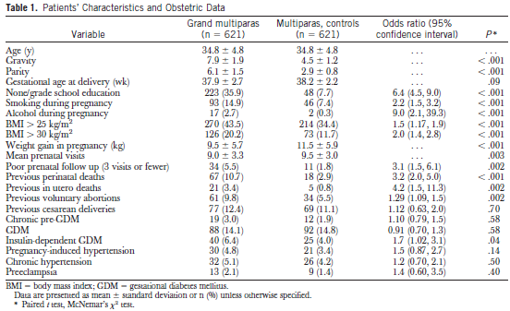
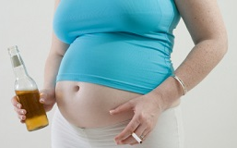
GMP (≥5) n= 621 Matched for age with MP (2-4) n= 621
Roman H, Obstet Gynecol 2004
Notes:
OBJECTIVETo compare the incidence of antenatal and intrapartum complications and neonatal outcomes among grand multiparas with age-matched multiparas.METHODS: Six hundred twenty-one grand multiparas (para more than 4) women were prospectively compared with 621 age-matched multiparous (para 2-4) controls. RESULTS: Grand multiparity was associated with low socioeconomic status and education (odds ratio [OR]6.4; 95% confidence interval [CI]4.5, 9.0), poorer prenatal care (OR 3.1; 95% CI 1.5, 6.1), smoking (OR 2.2; 95% CI 1.5, 3.2), and alcohol consumption (OR 9.0; 95% CI 2.1, 39.3). Grand multiparas had a higher body mass index (OR 1.5; 95% CI 1.2, 1.9) and rate of insulin-dependent gestational diabetes (OR 1.7; 95% CI 1.02, 3.1). They had more previous intrauterine (OR 4.2; 95% CI 1.5, 11.3) and perinatal deaths (OR 3.2; 95% CI 2.0, 5.0). They had fewer intrapartum complications (arrests of cervical dilatation [OR 0.19; 95% CI 0.06, 0.66], instrumental deliveries [OR 0.31; 95% CI 0.16, 0.59], and fever during labor [OR 0.47; 95% CI 0.26, 0.86]). Conditional logistic regression models found that grand multiparity was the most closely correlated factor to a previous history of fetal death (OR 4.3; 95% CI 1.6, 11.6), but it was not an independent predictor of insulin-dependent gestational diabetes mellitus (OR 1.3; 95% CI 0.75, 2.2).CONCLUSION: Grand multiparas, when compared with same-age multiparous controls, appear to have fewer intrapartum complications. However, they present several prenatal risk factors that require special antenatal care.

Slide 23
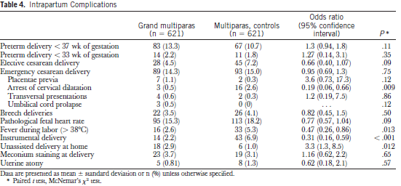
Roman H, Obstet Gynecol 2004
Notes:
OBJECTIVETo compare the incidence of antenatal and intrapartum complications and neonatal outcomes among grand multiparas with age-matched multiparas.METHODS: Six hundred twenty-one grand multiparas (para more than 4) women were prospectively compared with 621 age-matched multiparous (para 2-4) controls. RESULTS: Grand multiparity was associated with low socioeconomic status and education (odds ratio [OR]6.4; 95% confidence interval [CI]4.5, 9.0), poorer prenatal care (OR 3.1; 95% CI 1.5, 6.1), smoking (OR 2.2; 95% CI 1.5, 3.2), and alcohol consumption (OR 9.0; 95% CI 2.1, 39.3). Grand multiparas had a higher body mass index (OR 1.5; 95% CI 1.2, 1.9) and rate of insulin-dependent gestational diabetes (OR 1.7; 95% CI 1.02, 3.1). They had more previous intrauterine (OR 4.2; 95% CI 1.5, 11.3) and perinatal deaths (OR 3.2; 95% CI 2.0, 5.0). They had fewer intrapartum complications (arrests of cervical dilatation [OR 0.19; 95% CI 0.06, 0.66], instrumental deliveries [OR 0.31; 95% CI 0.16, 0.59], and fever during labor [OR 0.47; 95% CI 0.26, 0.86]). Conditional logistic regression models found that grand multiparity was the most closely correlated factor to a previous history of fetal death (OR 4.3; 95% CI 1.6, 11.6), but it was not an independent predictor of insulin-dependent gestational diabetes mellitus (OR 1.3; 95% CI 0.75, 2.2).CONCLUSION: Grand multiparas, when compared with same-age multiparous controls, appear to have fewer intrapartum complications. However, they present several prenatal risk factors that require special antenatal care.

Slide 24
Data are not adequate to support or refute an association between grand multiparity and:
Gestational hypertension/preeclampsia
Pregestational/gestational diabetes
Malpresentation/operative delivery
Dysfunctional labor/prolonged labor
Preterm birth/low birthweight
Neonatal intensive care unit admission
Perinatal death

Slide 25
Some problems with the available data are that most reports have not distinguished between chronic hypertension, gestational hypertension, and preeclampsia or between pregestational and gestational diabetes
many studies did not adjusted for confounders; and reports on the risk of perinatal death did not control for concurrent maternal medical problems.

Slide 26
Different perspectives
Qatar’s Ministry of Development Planning and Statistics, December 2016

Slide 27
GRAND MULTIPARITY: AN OBSTETRIC EXAGGERATION!
Background: There is no consensus in the medical literature on the association of grand multiparity and adverse pregnancy outcomes. We aimed in our study to evaluate the obstetric impact of grand multiparity in a homogenous Qatari population.
Methods: This study involved a retrospective chart review from January 1st, 2009 to December 31st, 2009 to compare obstetric outcomes of grand multiparous women, GM (range 5-12, n= 204) with low parity women, LP (parity of one or two, n= 447).We included Qatari healthy pregnant mothers with singleton gestations with similar demographics who had antenatal follow up and gave birth after 24 weeks gestation. The obstetrical outcomes of interest were gestational diabetes, hypertensive disorder of pregnancy, macrosomia, shoulder dystocia, IUFD, NICU admission, APH, PPH and primary caesarean section. Comparisons were analyzed with t test, Chi square and Odds ratio calculations. Logistic regression model was created to control for confounding variables such as age and BMI.
Results: GM women were older than LP women. However it was not statistically significant, p= 2.0. The GM women had a higher incidence of obesity (BMI≥30) compared to LP women (OR 2.3; 95%CI 1.2-4.8; p<0.005). Compared to LP women, GM women had a higher incidence of gestational diabetes (GDM). Index GM group 50% (103/204) compared to 23% (106/447) in the control group (OR 3; 95% CI 2.3 -4.6; p <0.001) this finding was still significant even after adjusting for maternal age and BMI (Adj OR 2.5; 95% CI 1.6-3.8; p <0.001). There was no statistical difference in hypertensive disorder of pregnancy, macrosomia, shoulder dystocia, IUFD, NICU admission, APH, PPH and the rate of primary caesarean section between the two groups.
Conclusion: Except for development of GDM; grand multiparity does not exert higher risk for obstetric complications compared to low parity population. In a population with stable socioeconomic status, with open and free access for health care, grand multiparity should not be considered a significant obstetric risk factor.
Al-Obaidly S et al. Sidra-RCOG Hot Topics in Obstetrics and Gynecology Conference 2014, Doha-Qatar
Notes:
Sidra-RCOG Challenges in Obstetrics and Gynecology Conference 2014, Doha-Qatar

Slide 28
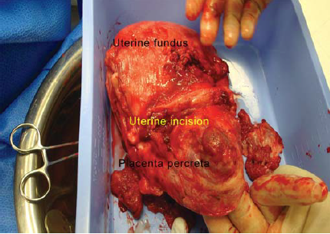
Role of Previous Cesarean Delivery
The route of previous deliveries is a key factor to consider when evaluating the risk of adverse pregnancy outcome.
Large observational studies have consistently shown that women who undergo multiple repeat cesarean deliveries are at increased risk of maternal morbidity, and the risk increases with the number of cesarean deliveries.

Slide 29
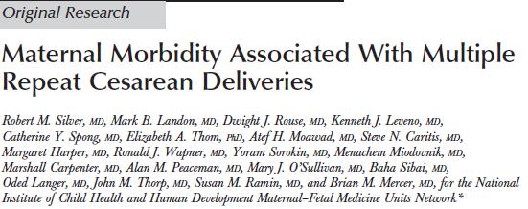
The largest prospective study of maternal morbidity associated with multiple cesarean deliveries included 6201 first; 15,808 second; 6324 third; 1452 fourth; 258 fifth; and 89 sixth cesarean deliveries.
The odds of placenta previa and accreta progressively increased with the number of cesarean deliveries, and women with placenta previa were at very high risk of also having placenta accreta.
The risk of peripartum hysterectomy at the fourth cesarean delivery was 1 in 40, increasing to 1 in 11 at the sixth cesarean delivery.
Silver RM et al, Obstet Gynecol 2006
Notes:
Silver RM et al, Obstet Gynecol 2006

Slide 30
Risk of complications associated with cesarean delivery according to the number of previous cesarean deliveries
Number of previous cesarean deliveries | Risk of complications, percent
 | Placenta accreta | Hysterectomy | Transfusion | Cystotomy | Bowel injury | Maternal death*
1 | 0.24 | 0.65 | 4.05 | 0.13 | 0.11 | 0.19
2 | 0.31 | 0.42 | 1.53 | 0.09 | 0.06 | 0.07
3 | 0.57 | 0.90 | 2.26 | 0.28 | 0.13 | 0.05
4 | 2.13 | 2.41 | 3.65 | 1.17 | 0.34 | 0.07
5 | 2.33 | 3.49 | 4.26 | 1.94 | 0.00 | 0.00
6 | 6.74 | 8.99 | 15.73 | 4.49 | 1.12 | 0.00
* Only 2 of the 27 maternal deaths were potentially related to the cesarean delivery itself. Both occurred in women having their second cesarean delivery. This study did not have adequate power to determine whether rare but serious events, such as maternal death, increased as the number of cesarean deliveries increased.
Silver RM et al, Obstet Gynecol 2006

Slide 31
Risk of placenta previa and accreta according to number of previous cesarean deliveries
Number of cesareans | Previa (percent) | Accreta (percent) | Accreta in patients with previa (percent)
Two | 1.33 | 0.31 | 11
Three | 1.14 | 0.57 | 40
Four | 2.27 | 2.13 | 61
Five | 2.33 | 2.33 | 67
Six or more | 3.37 | 6.74 | 67
The baseline risk of placenta previa in the general obstetrical population is 1 in 200 deliveries. Placenta accreta occurs in fewer than 1 in 500 deliveries.
Silver RM et al, Obstet Gynecol 2006

Slide 32
TOLAC
The risk of uterine rupture may be increased in grand multiparity, and is known to be increased in any woman undergoing a trial of labor after cesarean delivery (TOLAC).

Slide 33
A retrospective study reported the rate of uterine rupture during a trial of labor after a single previous cesarean was no higher than the background risk associated with TOLAC.
6 uterine ruptures among 1922 TOLACs (0.3 percent) in women with ≥6 births and 1 previous cesarean.
Hochler H et al, Obstet Gynecol 2014
Notes:
TISafety of trial of labor after cesarean delivery in grandmultiparous women.AUHochler H, Yaffe H, Schwed P, Mankuta D SOObstet Gynecol. 2014 Feb;123(2 Pt 1):304-8. OBJECTIVETo evaluate the risk of uterine rupture and other major labor complications in a trial of labor after cesarean delivery (TOLAC) in grandmultiparous women.METHODSA retrospective descriptive study of 64,345 births in three hospitals between the years 1999 and 2009. The study group included 1,922 deliveries of women in their sixth or higher birth with one previous cesarean delivery.RESULTSThe risk for uterine rupture was 0.3% (six cases) (95% confidence interval [CI]0.11-0.68); of these, two cases ended in hysterectomy. There were another four hysterectomies not attributable to uterine rupture (a total risk of 0.3%). Neither induction nor augmentation of labor increased the risk for uterine rupture. Trial of labor after cesarean delivery in the first labor after prior cesarean delivery conferred a higher risk for hysterectomy (1% compared with 0.1%; P=.019). In the presence of shoulder dystocia (n=20), the risk of uterine rupture was 10% (two cases) compared with 0.2% when shoulder dystocia did not occur (P=.002; odds ratio 52.7, 95% CI 9-306).CONCLUSIONGrandmultiparous women with one previous cesarean delivery can be offered TOLAC. Labor induction is not contraindicated in such women.LEVEL OF EVIDENCE: III.ADDepartment of Obstetrics and Gynecology, Shaare Zedek Medical Center, and the Department of Obstetrics and Gynecology, Hadassah Hospital, Ein Kerem, The Hebrew University of Jerusalem, Jerusalem, Israel.

Slide 34
Other smaller series have reported mixed results.
It is difficult to determine the true risk of uterine rupture in these studies because of the low rate of this complication and differences in study methods and terminology.
Ali AM et al, J Obstet Gynaecol Res 2002 Dyack C et al, J Obstet Gynaecol Res. 1997
Kugler E et al, Arch Gynecol Obstet 2008
Notes:
Ali AM et al, J Obstet Gynaecol Res 2002 Dyack C et al, J Obstet Gynaecol Res. 1997
Kugler E et al, Arch Gynecol Obstet 2008

Slide 35
Long-term Risks
The long-term maternal effects of grand multiparity are not well established.
There is convincing evidence that the risk of pelvic organ prolapse increases with increasing parity.
Specific factors, such as forceps delivery, may be particularly important.
Mant J et al, Br J Obstet Gynaecol 1997
Moalli PA et al, Obstet Gynecol 2003
Notes:
Mant J et al. Br J Obstet Gynaecol 1997
Moalli PA et al, Obstet Gynecol 2003

Slide 36
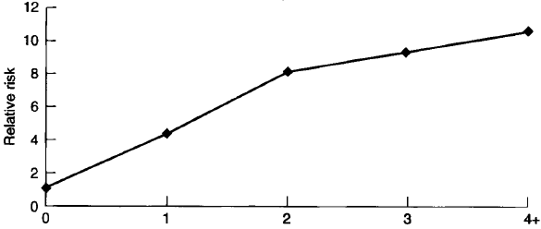
As an example, in the Oxford Family Planning study, a prospective cohort study of more than 17,000 women followed for 17 years, the risk of hospital admission for pelvic organ prolapse increased markedly after the first and second births compared with nulliparity (four-fold and eight-fold increase, respectively), but increased less rapidly for subsequent births (nine-fold increase after the third birth; 10-fold increase after the fourth birth).
Mant J et al, Br J Obstet Gynaecol 1997

Slide 37
The prevalence of diastasis recti increases with increasing parity.
Grand multiparity has been consistently associated with a decreased risk of breast cancer, and a decreased risk for some cancers of the reproductive tract (eg, endometrialand ovarian but not cervical.
Other outcomes have not been evaluated extensively in grand multiparous versus multiparous women. It has been associated with permanent weight gain in some subgroups of women and an increased risk of diabetes.
Högnäs E et al, Obstet Gynecol 2014
Abrams B et al, Obesity 2013
Araneta MR et al, Diabetes Care 2010
Notes:
The prevalence of diastasis recti increases with increasing parity. (See "Rectus abdominis diastasis", section on 'Pregnancy'.) Increasing parity does not appear to be a risk factor for osteoporosis [48-54].
Grand multiparity has been consistently associated with a decreased risk of breast cancer [55-58], and a decreased risk for some cancers of the reproductive tract (eg, endometrial [55,59,60] and ovarian [55,61] but not cervical [62]). It has also been associated with an increased risk of some cancers, such as the liver/biliary tract, but data are less consistent [55,63-65]. These findings require further investigation to better understand confounding factors, such as age, obesity, smoking, and duration of breastfeeding.
Other outcomes have not been evaluated extensively in grand multiparous versus multiparous women. It has been associated with permanent weight gain in some subgroups of women [66] and an increased risk of diabetes [32,67].

Slide 38
SUMMARY
Although grand multiparity has been associated with a number of obstetric complications, most grand multiparas have similar birth outcomes when compared with women of lower parity, especially in settings where modern obstetrical care is readily available.
The maximum number of pregnancies that is safe for mother and baby is unclear, and factors other than obstetrical issues need to be considered.
Most of the complications that have been associated with grand multiparity may actually be confounded by advanced maternal age and its associated comorbidities.
Thus, in patients without underlying comorbidity, grand multiparity does not appear to be an independent risk factor for severe obstetric complications, except for placenta previa and abruption.
Notes:
SUMMARY AND RECOMMENDATIONS
●Although grand multiparity has been associated with a number of obstetric complications, most grand multiparas have similar birth outcomes when compared with women of lower parity, especially in settings where modern obstetrical care is readily available.
●The maximum number of pregnancies that is safe for mother and baby is unclear, and factors other than obstetrical issues need to be considered. Most of the complications that have been associated with grand multiparity may actually be confounded by advanced maternal age and its associated comorbidities. Thus, in patients without underlying comorbidity, grand multiparity does not appear to be an independent risk factor for severe obstetric complications, except for placenta previa and abruption.

Slide 39
SUMMARY
Women who undergo multiple repeat cesarean deliveries are at increased risk of maternal morbidity, particularly placenta previa and accreta. The risk increases with the number of cesarean deliveries.
Antepartum clinical care is similar for all multiparous women, regardless of the number of previous deliveries.
Grand multiparity per se is not a contraindication for TOLAC
During labor, providers caring for grand multiparas should anticipate and be prepared to manage macrosomia (and shoulder dystocia), labor abnormalities (including dystocia related to macrosomia or malposition), and postpartum hemorrhage.
The long-term maternal effects of grand multiparity are not well established. The best evidence is for an increased risk of pelvic organ prolapse.
Notes:
Women who undergo multiple repeat cesarean deliveries are at increased risk of maternal morbidity, particularly placenta previa and accreta. The risk increases with the number of cesarean deliveries.
Antepartum clinical care is similar for all multiparous women, regardless of the number of previous deliveries. In women with a prior cesarean delivery, we do not advise against a trial of labor based on grand multiparity alone. During labor, providers caring for grand multiparas should anticipate and be prepared to manage macrosomia (and shoulder dystocia), labor abnormalities (including dystocia related to macrosomia or malposition), and postpartum hemorrhage.
The long-term maternal effects of grand multiparity are not well established. The best evidence is for an increased risk of pelvic organ prolapse.

Slide 40
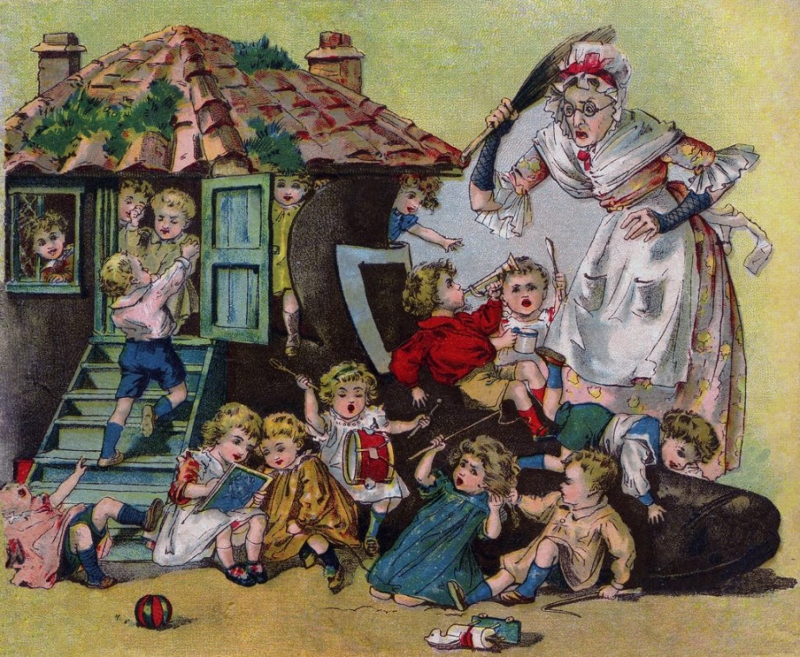
“A woman could, in theory, become the mother to more children than we ever thought possible”
James Segars, director of the Division of Reproductive Science and Women’s Health Research at Johns Hopkins University.
(BBC interview 2015)
Notes:
http://www.bbc.com/future/story/20151020-did-one-woman-really-give-birth-to-69-children

Slide 41
THANK YOU
qatarfetus@gmail.com
Notes:
@SawsanAlobaidly
qatarfetus@gmail.com

