Slide 1


Hereditary Breast and Ovarian Cancer Syndromes:
Beyond BRCA 1 and 2: How far can we go?
Muhieddine Seoud, MD, FACOG, FACS
American University of Beirut Medical Center
Kuwait City, Kuwait, February 2017

Slide 2




Slide 3
Hereditary breast and ovarian cancer (HBOC):
Objectives
Review the rapidly changing landscape of HBOC syndromes
Emphasize the importance of history taking in familial cancer syndromes
Identify and select appropriate genetic counseling/testing/companion diagnostics to evaluate germline, somatic and epigenetic alterations
Present available data on lifetime risk of various mutations in various cancers
Summarize the current recommendations for risk reducing interventions
Take home message

Slide 4
HBOC: Facts
The hallmarks of hereditary cancer syndromes:
  Multiple affected family members
  Early age of onset
  Multiple and/or bilateral primary cancers
Multiple syndromes associated with increase risks
1. Ohio Cancer Incidence Surveillance System, Ohio Department of Health, 2011 2. Anderson MR et al. Cancer 2008;113:484-489. 3. Myers ER et al. Evidence Report Technology Assessment 2006 full report 1-145. 4. Cancer Research UK. http://info.cancerresearchuk.org/cancerstats/types/ovary/survival/index.htm#Five-year

Slide 5
Case report: Ms. C.S. : 3 cancers in one, all missed
52 years old single female presenting with abdominal carcinomatosis
Sister had serous ovarian cancer at age 43: omission # 1
At age 47:
  Myomectomy for an 18 cm myoma
  Left 2 cm breast mass: no Work-up and no FU: omission # 2
6 months later, left triple negative breast cancer:
  Lumpectomy and SLN- chemo/radio/no tamoxifen
Right adnexal mass-observed-stable: omission # 3
At age 52: Abdominal carcinomatosis-bilateral ovarian cancers stage IIIC
Referred for management –
  2 cm thyroid nodule discovered- FNA thyroid papillary cancer: omission # 4

Slide 6
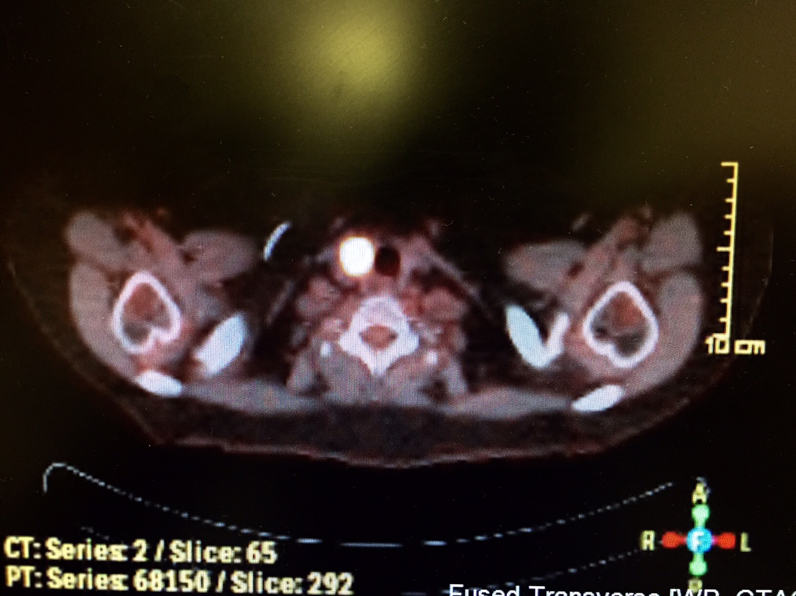
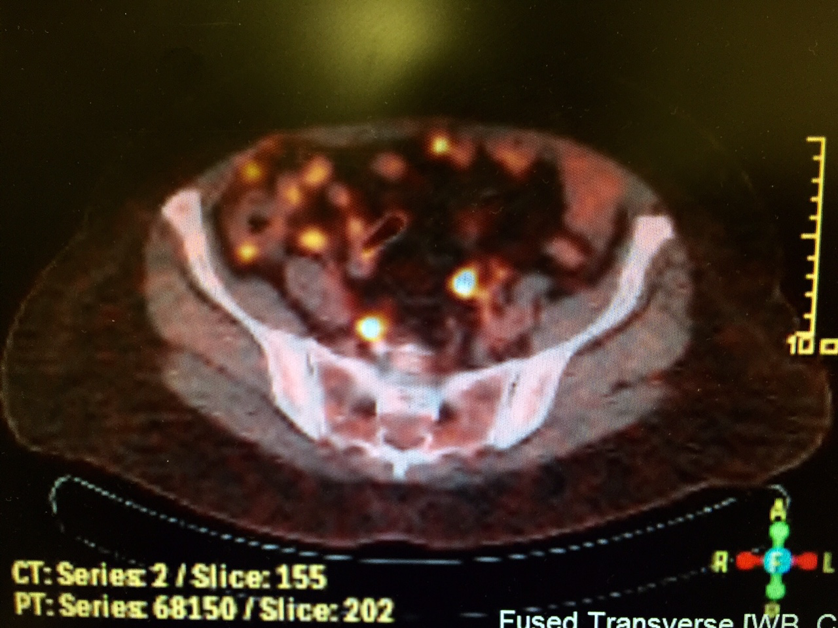
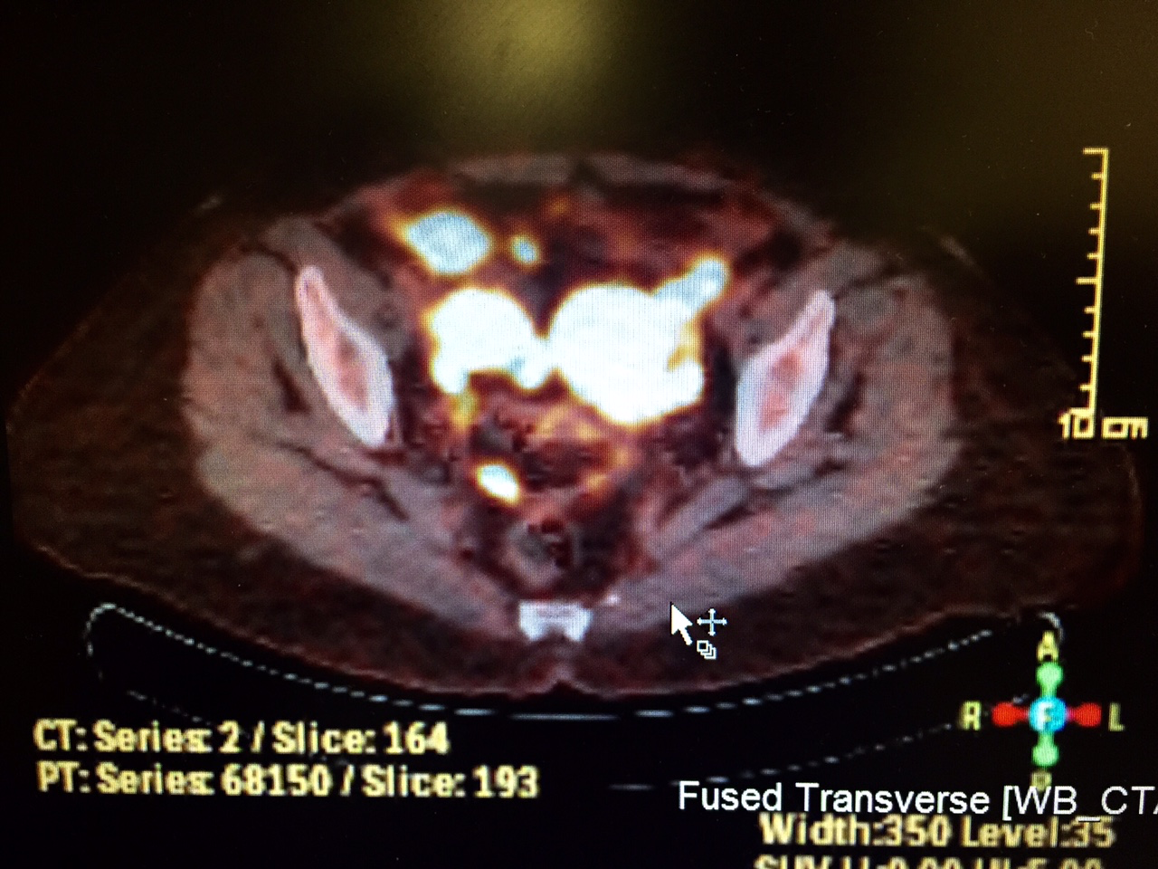

Slide 7
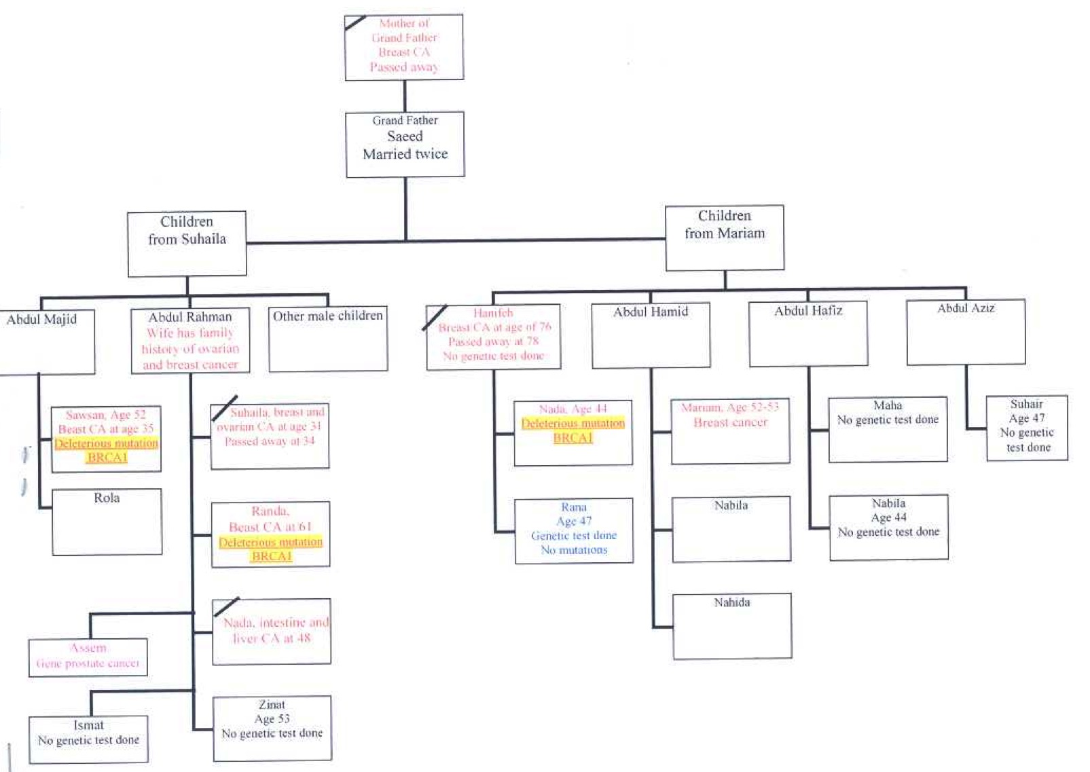
Case report: Ms. N.S.

Slide 8

Patient Cancer Family History
No
Yes
Does the family history raise red flags ?
No
Yes:
Hereditary Cancer Testing
Negative or VUS
Positive Mutation
General Population | Familial Risk | Hereditary Risk

Slide 9
HBOC: Types of genetic events
Germline mutations in DNA repair pathways
  Variation in the lineage of germ cells that can be transmitted to offspring
  ~ 20-30% of patients with BCA may carry it
    8-10% have a family history of the ds and may carry mutations in BRCA ½
    8-10% without family history of the ds and may carry mutations in BRCA ½
  ~ 22% of patients in a breast surgery practice may be appropriate for BRCA testing
Somatic mutations in BRCA:
  Alterations in DNA after conception in cells except germ cells
  Can be passed through cell division to progeny of mutated cells but not to offspring
Epigenetic factors
  Heritable changes in gene expression (not involving DNA sequence)
  Change in phenotype without change in genotype
1. Alsop K et al. J Clin Oncol 2012;30:263-63. 2. Liu et al. Clin Cancer 2014;205150-5156. 3. Lodhia K et al. Ann Oncol 2015;26;ii31 Pennongton KP et al. Clin Cancer Res 2014;20:764-75

Slide 10
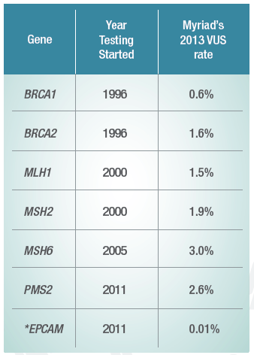
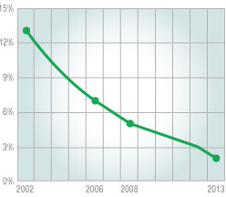
HBOC: Types of genetic events
BRCAness:
  Tumors may carry mutations in other proteins associated with DNA repair
Caveats:
  Unknown risk from specific mutations: (Variance of Undermined Significance )
  Unknown impact on prognosis & response rates for some of these mutations
  The science is rapidly progressing
1. Alsop K et al. J Clin Oncol 2012;30:263-63. 2. Liu et al. Clin Cancer 2014;205150-5156. 3. Lodhia K et al. Ann Oncol 2015;26;ii31 Pennongton KP et al. Clin Cancer Res 2014;20:764-75

Slide 11
Germline mutations and cancer risk
Sporadic cancer: 2 acquired mutations
2 working copies
1 working copy
1 mutation
2 mutations
tumor develops
Hereditary cancer: 1 inherited and 1 acquired mutation
1 working copy
1 mutation
2 mutations
tumor develops

Slide 12
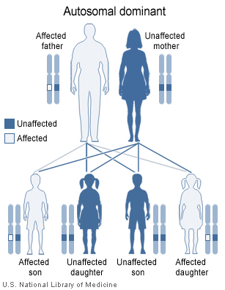
Parent of either sex has a 50-50 chance of passing a mutation to a child of either sex
Paternal family history shouldn’t be ignored when we’re discussing BCA or OCA

Slide 13
HBOCS: Patients with an increased likelihood of having an inherited predisposition
Women AFFECTED with:
High grade EOC/TC/PPC
BCA ≤ 45 years
BCA with:
  close relative^{b} with BCA ≤ 50 yrs
  close relative^{b} with EOC/TC/PPC
BCA ≤ 50 years with a limited family history^{c}
BCA with ≥ 2 close relatives^{b} with BCA at any age
BCA with ≥ 2 close relatives^{b} with pancreatic cancer, prostate cancer (GS ≥ 7)
2 breast 1ries, with the 1rst dx < 50 ys
Triple negative BCA ≤ 60 years
BCA and Ashkenazi Jewish ancestry
Pancreatic cancer with ≥ 2 close relatives^{b} with BCA, prostate cancer (GS ≥ 7)
b Close relative is defined as a first degree (parent, sibling, offspring), second degree (grandparent, grandchild, uncle, aunt, nephew, niece, half-sibling) or third degree (first cousin, great-grandparent or great-grandchild) relative
c Limited family history includes fewer than 2 first- or second-degree female relatives of female relatives surviving beyond 45 years.
Notes:
Five-year survival is over 90 percent for the minority of women with stage I disease. This number drops to about 75 to 80 percent with regional disease, and 25 percent for those with distant metastases.
Despite the good prognosis associated with early stage disease, overall five-year survival in women with ovarian cancer is less than 45 percent, in large part because the cancer has spread beyond the ovary at the time of clinical detection in 75 percent of patients.
Mortality from ovarian cancer has decreased only slightly in the past 30 years.
Little is known about the mechanism or timing of progression from localized to disseminated ovarian cancer. The model of unifocal disease progressing to diffuse disease is plausible; ovarian cancer also may develop from multiple foci within the abdomen since carcinomatosis can develop after the removal of normal ovaries.

Slide 14
HBOCS: Patients with an increased likelihood of having an inherited predisposition
Women UNAFFECTED with cancer, but with:
A 1rst degree or several close relatives that meet one of the above criteria
A close relative^{b} carrying a known BRCA1 or BRCA2 mutation
A close relative with male breast cancer
b Close relative is defined as a first degree (parent, sibling, offspring), second degree
(grandparent, grandchild, uncle, aunt, nephew, niece, half-sibling) or third degree (first cousin, great-grandparent or great-grandchild) relative .
Notes:
Five-year survival is over 90 percent for the minority of women with stage I disease. This number drops to about 75 to 80 percent with regional disease, and 25 percent for those with distant metastases.
Despite the good prognosis associated with early stage disease, overall five-year survival in women with ovarian cancer is less than 45 percent, in large part because the cancer has spread beyond the ovary at the time of clinical detection in 75 percent of patients.
Mortality from ovarian cancer has decreased only slightly in the past 30 years.
Little is known about the mechanism or timing of progression from localized to disseminated ovarian cancer. The model of unifocal disease progressing to diffuse disease is plausible; ovarian cancer also may develop from multiple foci within the abdomen since carcinomatosis can develop after the removal of normal ovaries.

Slide 15
NCCN Guidelines For Germline Testing
Personal history of EOC, FTC, or PPC
Not dependent on family history
Not dependent on ethnicity (i.e. Ashkenazi descent)
Not dependent on tumor pathology (i.e. serous histology)
Version 1.2011 onward, www.nccn.org

Slide 16
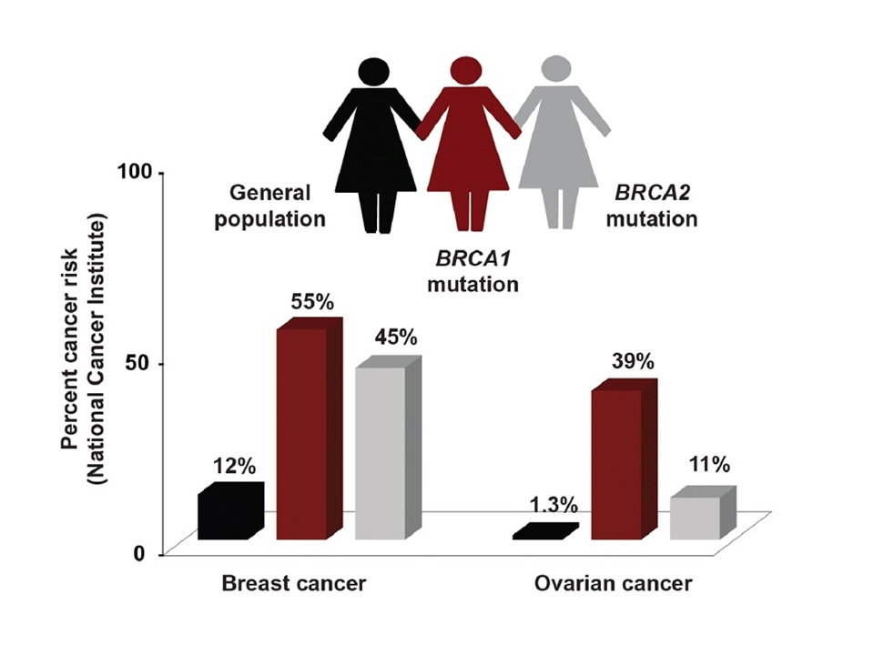

Slide 17
Hereditary Susceptibility To Ovarian/Breast Cancer:
Changing Prevalence-Changing Landscape: 2002
BRCA2 (30%)
BRCA1 (65%)
HNPCC (7%)
Hereditary (10%)
Sporadic (90%)
Lifetime risk 15-30%
Lifetime risk 30-60%
Rebbeck TR, Lynch HT, et al. NEJM 2002

Slide 18
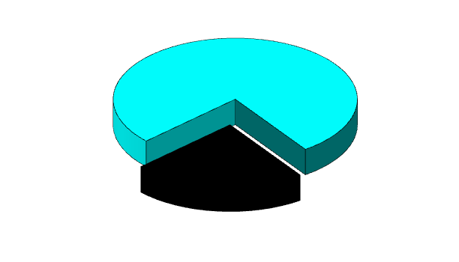
Summary of Cancer- Associated Mutations: GOG 218 and 262:
Changing Prevalence-Changing Landscape: SGO March 2016
Prevalence increased from 10% to 24%
Sporadic
BRCA1
(~45%)
Hereditary
(~24%)
BRCA2 (~27%)
Other single genes
(~27%)
Lynch
(<1%)
wisher
Norquist B et al., SGO March 2016

Slide 19
Summary of Cancer- Associated Mutations: GOG 218 and 262:
Changing Prevalence-changing landscape: SGO March 2016
Prevalence increased from 10% to 24%
RAD51C
Massively parallel sequencing (NGS)
Unselected by age or history
24% of 360 pts had mutation in ≥1 of 21 TS genes
>30% had no family history
>35% were ≥ 60 yrs at diagnosis
Mutations most common in but not limited to grade 3 serous cancer
RAD50
TP53
PALB2
NBN
3
3
MSH6
2
1
MRE11
1
2
CHEK2
1
5
BRIP1
4
BARD1
1
Other single genes: (~27%)
Norquist B et al., SGO March 2016

Slide 20
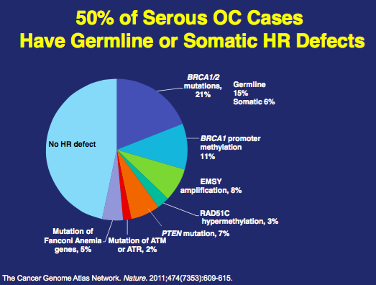
More Than BRCA1/2? : The Concept Of “Brca-ness”
The Cancer Genome Atlas (TCGA) Network:
50% Of 489 Serous OVC Have Germline Or Somatic HR Defects
DNA repair by HR: Defects in the FA-BRCA pathway result in HR deficiency (HRD)
ATM
Ub
BARD1
CHEK2
BRCA1
FANCD2
BRIP1
BRCA2
RAD51C
PALB2
NBS1
MRE11
RAD50
Fanconi Anemia-BRCA pathway
TCGA Netwoek. Nature 2011;474(7353):609-15

Slide 21
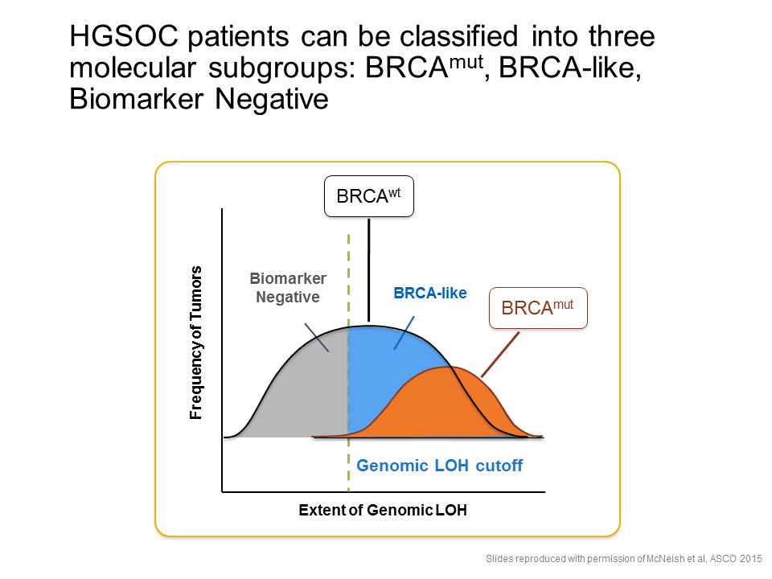
HGSOC patients can be classified into 3 molecular subgroups:
BRCA^{mut}, BRCA-like, Biomarker-negative

Slide 22
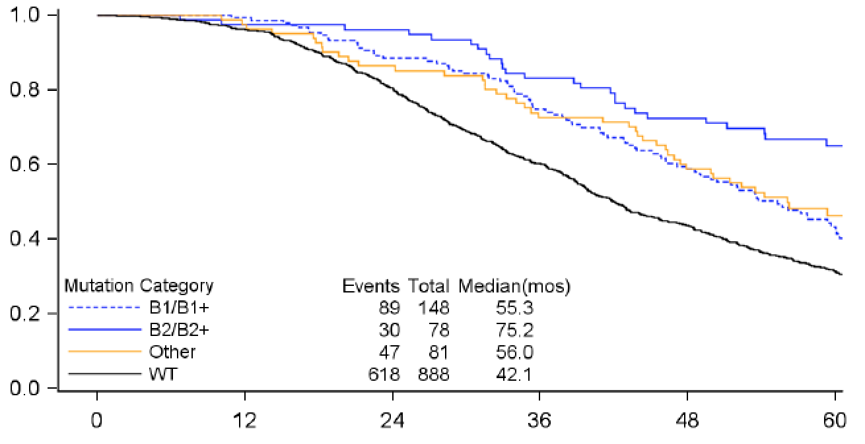
Overall survival by mutation status
Mutations in HR Genes and Response to RX in GOG 218: an NRG Oncology Study Barbara Norquist, MD U.Wash./, Seattle, WA
SGO, MARCH 2016
Median Months OS:
BRCA2:
BRCA1:
Other:
No Mutation:
Proportion surviving
75.2
55.3
56.0
42.1
Months on study
Norquist B et al., SGO March 2016
Notes:
BRCA2 vs. no mutation = 33.1 months difference in median OS

Slide 23
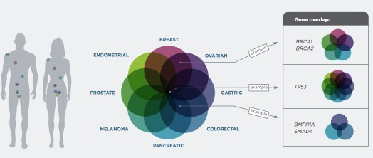
Each cancer site is associated with multiple hereditary cancer syndromes:
23 Genes panel
APC, ATM, BARD1, BMPRIA, BRCA1, BRCA2, BRIP1, CDKN2A, CDK4, CHECK2, MLH1, MSH2, MSH6, MUTYH, NBN, PALB2, PMS2, PTNE, RAD1C, RAD1D, SMAD4, STK11 and TP53

Slide 24
Elevated risk Risk
Does not meeting HR criteria
Single study
Contradictory data
High Risk
3 x higher > general population
Absolute risk ~ > 5%
Multiple supporting studies

Slide 25
NCCN 21st Annual Conference,
Changing Prevalence: April 02, 2016
Several new genetic mutations for HBOCs
PALB2 mutations are associated with:
  A 35 to 40% risk of BCA
  An aggressive form of BCA (# from BRCA 1)
RAD51C, RAD51D, and BRIP1 mutations pose an added lifetime risk for OCA
NCCN guidelines are not recommending yet BSO when these genetic mutations are present, only that the possibility of the procedure should be discussed
List of genetic mutations for which RR mastectomy is recommended:
  BRCA1, BRCA2, PTEN, PT53, and PALB2
Pal et al NCCN 21th Annual Confe Apri 2l 2016

Slide 26
HBOCS: Facts
Women with Lynch HNPCC syndrome:
Mutations in DNA mismatch-repair genes:
  MLH1, MSH2, MSH6, or PMS2
  MSI
25–50%-70% lifetime risk of colorectal cancer (lower than male counterparts)
Cancer | Lifetime Risk
 | MLH1 | MSH2 | MSH6 | PMS2
Endometrial | 20–54% | 21–49% | 16–71% | 15%
OVC/FT/PC by age 70 | 4–20% | 7.5–24% | 0–13.5% | small
1. Ohio Cancer Incidence Surveillance System, Ohio Department of Health, 2011 2. Anderson MR et al. Cancer 2008;113:484-489. 3. Myers ER et al. Evidence Report Technology Assessment 2006 full report 1-145. 4. Cancer Research UK. http://info.cancerresearchuk.org/cancerstats/types/ovary/survival/index.htm#Five-year

Slide 27
HBOCS:
Cowden syndrome
Germline mutations in the PTEN gene
19–28% risk of endometrial cancer by age 70
  True risk higher with an intact uterus
50% risk of breast cancer
3–10% risk of thyroid cancer
1. Ohio Cancer Incidence Surveillance System, Ohio Department of Health, 2011 2. Anderson MR et al. Cancer 2008;113:484-489. 3. Myers ER et al. Evidence Report Technology Assessment 2006 full report 1-145. 4. Cancer Research UK. http://info.cancerresearchuk.org/cancerstats/types/ovary/survival/index.htm#Five-year
Notes:
Five-year survival is over 90 percent for the minority of women with stage I disease. This number drops to about 75 to 80 percent with regional disease, and 25 percent for those with distant metastases.
Despite the good prognosis associated with early stage disease, overall five-year survival in women with ovarian cancer is less than 45 percent, in large part because the cancer has spread beyond the ovary at the time of clinical detection in 75 percent of patients.
Mortality from ovarian cancer has decreased only slightly in the past 30 years.
Little is known about the mechanism or timing of progression from localized to disseminated ovarian cancer. The model of unifocal disease progressing to diffuse disease is plausible; ovarian cancer also may develop from multiple foci within the abdomen since carcinomatosis can develop after the removal of normal ovaries.

Slide 28
HBOCS:
Li Fraumeni syndrome
P 53 mutation carriers
60% lifetime risk of breast cancer
Sarcomas, brain, and adrenocortical carcinomas , etc..
HBOCS: Other genes
DICER1: Sertoli-Leydig tumors
SMARCA4: ovarian small cell carcinoma
1. Ohio Cancer Incidence Surveillance System, Ohio Department of Health, 2011 2. Anderson MR et al. Cancer 2008;113:484-489. 3. Myers ER et al. Evidence Report Technology Assessment 2006 full report 1-145. 4. Cancer Research UK. http://info.cancerresearchuk.org/cancerstats/types/ovary/survival/index.htm#Five-year
Notes:
Five-year survival is over 90 percent for the minority of women with stage I disease. This number drops to about 75 to 80 percent with regional disease, and 25 percent for those with distant metastases.
Despite the good prognosis associated with early stage disease, overall five-year survival in women with ovarian cancer is less than 45 percent, in large part because the cancer has spread beyond the ovary at the time of clinical detection in 75 percent of patients.
Mortality from ovarian cancer has decreased only slightly in the past 30 years.
Little is known about the mechanism or timing of progression from localized to disseminated ovarian cancer. The model of unifocal disease progressing to diffuse disease is plausible; ovarian cancer also may develop from multiple foci within the abdomen since carcinomatosis can develop after the removal of normal ovaries.

Slide 29
HBOCS:
Peutz–Jeghers syndrome
Less common
Mutations in STK11/LKB1 gene
10% risk of cervical (adenoma malignum)
21% risk of ovarian (sex cord stromal tumors)
50% risk of breast cancers
Other cancers: colon, pancreas, endometrium, gastric …..
1. Ohio Cancer Incidence Surveillance System, Ohio Department of Health, 2011 2. Anderson MR et al. Cancer 2008;113:484-489. 3. Myers ER et al. Evidence Report Technology Assessment 2006 full report 1-145. 4. Cancer Research UK. http://info.cancerresearchuk.org/cancerstats/types/ovary/survival/index.htm#Five-year
Notes:
Five-year survival is over 90 percent for the minority of women with stage I disease. This number drops to about 75 to 80 percent with regional disease, and 25 percent for those with distant metastases.
Despite the good prognosis associated with early stage disease, overall five-year survival in women with ovarian cancer is less than 45 percent, in large part because the cancer has spread beyond the ovary at the time of clinical detection in 75 percent of patients.
Mortality from ovarian cancer has decreased only slightly in the past 30 years.
Little is known about the mechanism or timing of progression from localized to disseminated ovarian cancer. The model of unifocal disease progressing to diffuse disease is plausible; ovarian cancer also may develop from multiple foci within the abdomen since carcinomatosis can develop after the removal of normal ovaries.

Slide 30
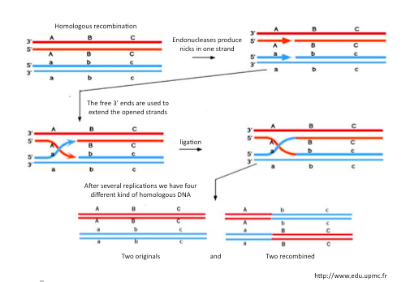
Homologous Recombination
Exchange of nucleotide between 2 similar or identical DNA strands
Conservative mechanism of DNA repair with few errors
Critical for repair of double-strand breaks

Slide 31
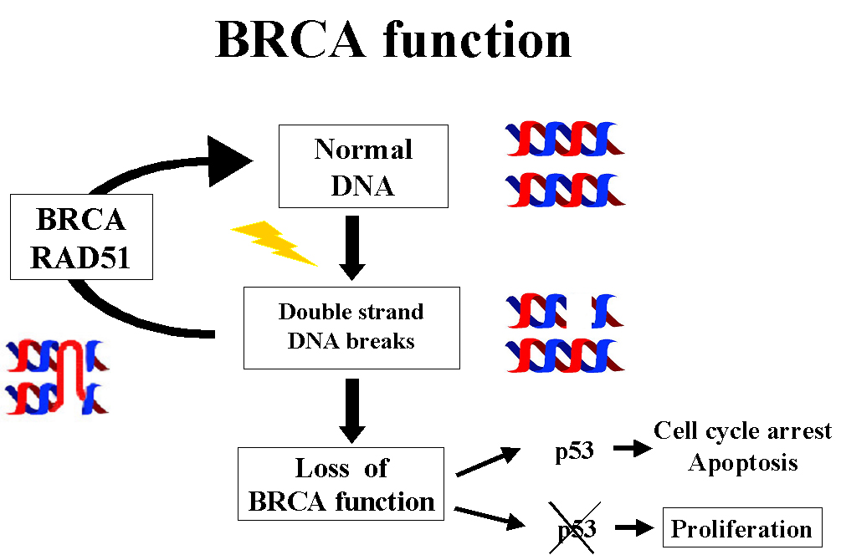
BRCA Function
Normal
DNA
BRCA
RAD51C
Double Strand
DNA breaks
P 53
Cell Cycle arrest: Apoptosis
Loss of
BRCA function
P 53
Proliferation

Slide 32
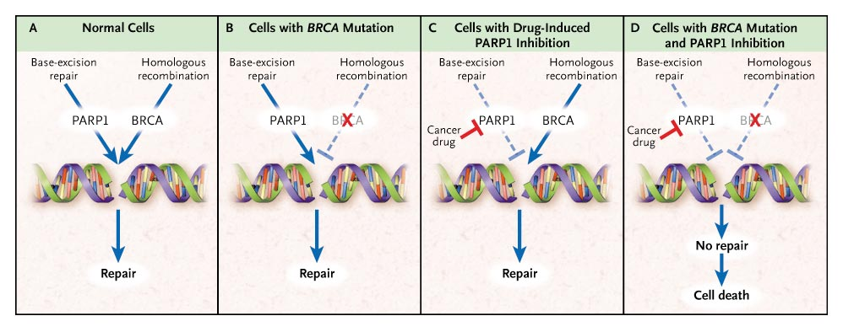
PARP Inhibition in BRCA-deficient Tumors
Accumulation of double strand breaks, in the absence of an alternative DNA repair mechanism, leads to cell death
Iglehart et al. NEJM 2009, Bryant et al. Nature 2005 , Farmer et al. Nature 2005
Notes:
These DSB are usually managed using the homologous recombination pathway in which BRCA1 and BRCA2 play a large role {Point C}.
Thus in the presence of a PARP inhibitor and defects in homologous recombination - for example in germline BRCA mutation carriers- {Point D} failure to repair leads to apoptosis in the presence of normal checkpoints

Slide 33
BRCA 1 and BRCA 2
BRCA1 and BRCA2 mutations:
  AD, highly penetrant, germline mutations on chromosomes 13, and 17
Lifetime risk varies among different populations:
  Penetrance
  Risk-modifiers
Different types of cancer and age of onset depending on:
  gene-gene interactions:
    Position of the mutation in the BRCA1 or BRCA2 gene
    Genetic variation in other genes
  gene-environment interactions:
    Age/Hormonal or reproductive factors/Lifestyle factors
The prevalence in the general population of European ancestry is ~ 0.25 %
  Higher in Norwegian, Dutch, and Icelandic ancestry
  Founder effect

Slide 34

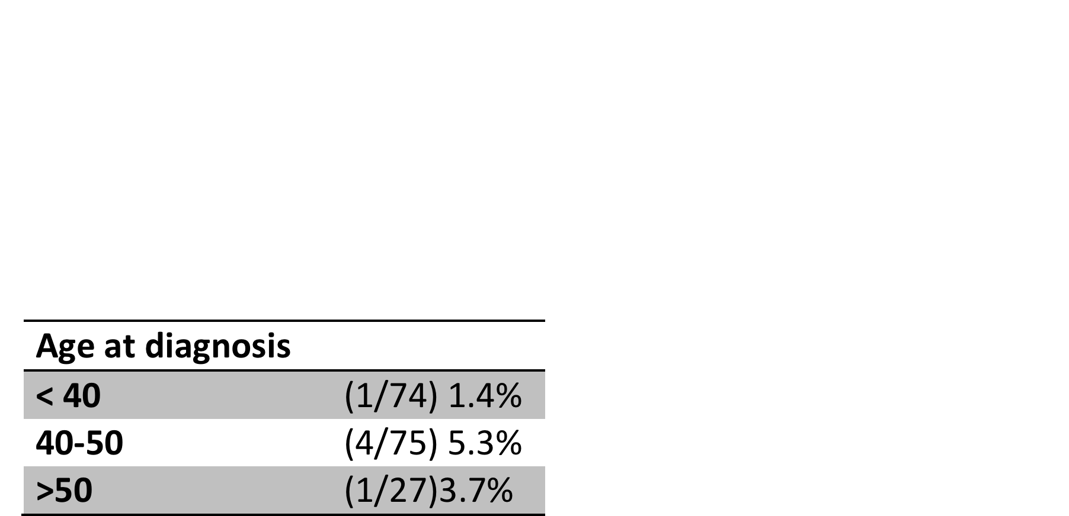
BRCA 1 and BRCA 2 mutations in ethnic lebanese Arab women with high risk hereditary breast cancer:
Saghir N, Zgheib N, Armstrong D, Seoud M et al.. Oncologist 2015
250 Lebanese women with breast cancer (2009-2012)
High risk of carrying BRCA1 or BRCA2 mutations
  young age
  positive family history of breast or ovarian cancer
Despite high percentage of breast cancer in young women of Lebanese and Arab descent
  Prevalence of deleterious BRCA is lower than expected
  Doesn’t support the hypothesis that BRCA mutations alone as a cause
Oncologist 2015;20:357-64

Slide 35
Mutations Dramatically increase the risk of developing cancer
Data From Myriad Genetic^{R}

Slide 36
HBOCS: Genetic Testing Debate
Changing Landscape
Single gene testing
Multigene panel
Traditional Sanger
Sequencing approach
Low throughput
High cost for multiple genes
Misses structural rearrangements
Massive parallel sequencing
High throughput
Lower cost for multiple genes
Better assessment of rearrangements
Large number of VUS
VUS, variants of uncertain significance www.cancer.gov/cancertopics/pdq/genetics/overview.
Notes:
Five-year survival is over 90 percent for the minority of women with stage I disease. This number drops to about 75 to 80 percent with regional disease, and 25 percent for those with distant metastases.
Despite the good prognosis associated with early stage disease, overall five-year survival in women with ovarian cancer is less than 45 percent, in large part because the cancer has spread beyond the ovary at the time of clinical detection in 75 percent of patients.
Mortality from ovarian cancer has decreased only slightly in the past 30 years.
Little is known about the mechanism or timing of progression from localized to disseminated ovarian cancer. The model of unifocal disease progressing to diffuse disease is plausible; ovarian cancer also may develop from multiple foci within the abdomen since carcinomatosis can develop after the removal of normal ovaries.

Slide 37
HBOCS: Genetic testing
Things to consider
Increase in complexity of testing technology
Uncertainty in the interpretation of the results
Range of potentially identifiable cancer-risk
Need for evaluating the likelihood of of a hereditary cancer syndrome
Choosing the appropriate test/panel, and interpreting the result, all clearly argue that
the first step in patient assessment should be genetic counseling
1. Ohio Cancer Incidence Surveillance System, Ohio Department of Health, 2011 2. Anderson MR et al. Cancer 2008;113:484-489. 3. Myers ER et al. Evidence Report Technology Assessment 2006 full report 1-145. 4. Cancer Research UK. http://info.cancerresearchuk.org/cancerstats/types/ovary/survival/index.htm#Five-year
Notes:
Five-year survival is over 90 percent for the minority of women with stage I disease. This number drops to about 75 to 80 percent with regional disease, and 25 percent for those with distant metastases.
Despite the good prognosis associated with early stage disease, overall five-year survival in women with ovarian cancer is less than 45 percent, in large part because the cancer has spread beyond the ovary at the time of clinical detection in 75 percent of patients.
Mortality from ovarian cancer has decreased only slightly in the past 30 years.
Little is known about the mechanism or timing of progression from localized to disseminated ovarian cancer. The model of unifocal disease progressing to diffuse disease is plausible; ovarian cancer also may develop from multiple foci within the abdomen since carcinomatosis can develop after the removal of normal ovaries.

Slide 38
HBOCS: Genetic counseling
Assessment for the presence of an inherited cancer syndrome
Education
Counseling
Evaluation of available tumor by IHC and MSI (somatic mutations)
Genetic counselor or others with expertise in cancer genetics
Germline genetic testing
1. Ohio Cancer Incidence Surveillance System, Ohio Department of Health, 2011 2. Anderson MR et al. Cancer 2008;113:484-489. 3. Myers ER et al. Evidence Report Technology Assessment 2006 full report 1-145. 4. Cancer Research UK. http://info.cancerresearchuk.org/cancerstats/types/ovary/survival/index.htm#Five-year
Notes:
Five-year survival is over 90 percent for the minority of women with stage I disease. This number drops to about 75 to 80 percent with regional disease, and 25 percent for those with distant metastases.
Despite the good prognosis associated with early stage disease, overall five-year survival in women with ovarian cancer is less than 45 percent, in large part because the cancer has spread beyond the ovary at the time of clinical detection in 75 percent of patients.
Mortality from ovarian cancer has decreased only slightly in the past 30 years.
Little is known about the mechanism or timing of progression from localized to disseminated ovarian cancer. The model of unifocal disease progressing to diffuse disease is plausible; ovarian cancer also may develop from multiple foci within the abdomen since carcinomatosis can develop after the removal of normal ovaries.

Slide 39
Risk reducing interventions/procedures
Procedure | Risk Reduction of ovarian cancer
Salpingo-oophorectomy | 71 - 96%
Tubal ligation | 18%
Salpingectomy | 70%
Occult cancers at the time of RRS is 2-18%
Cortesi, L., A. Toss, and E. De Matteis. "Preventive Strategies for Ovarian Cancer." (2013), Rice, Megan S. et al, International Journal of Cancer(2013), Aderson et al. Int J Gynecol Cancer 2013

Slide 40
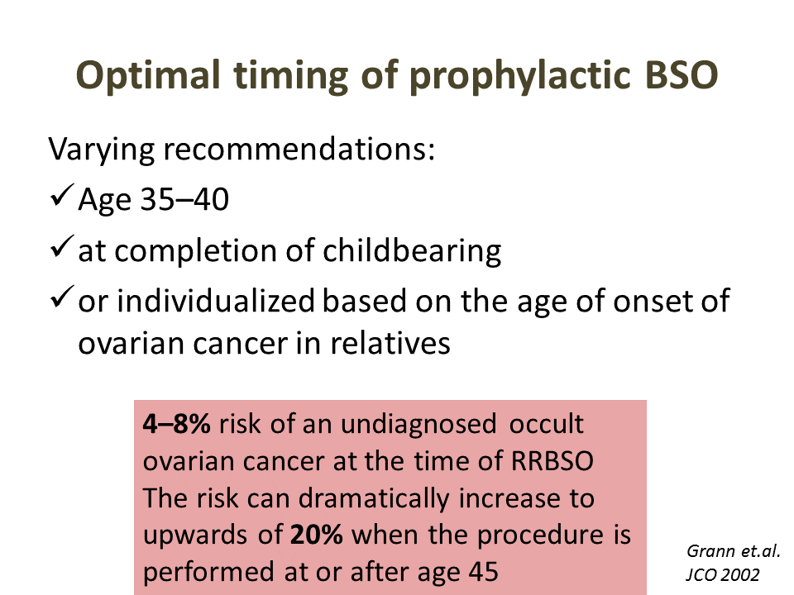

Slide 41
Take Home Messages
Consider taking a comprehensive personal and family history
Consider using a risk model to estimate the cancer risk (e.g. Claus model)
Consider a medical oncology genetic counseling when it looks too complicated
Consider testing when risk estimates are appropriate
Discuss risk reducing preventions/surgeries/…..
Discuss implications on the patient herself and her family members

