Slide 1
Critical review of interventions to reduce risk of preterm birth
Khaled Ismail MD, PhD, FRCOG
Professor of Obstetrics & Gynaecology
Honorary Director of eLearning, RCOG
Chair of European Perineal Trauma PEERS
Notes:
A pleased to present before a prestigious panel of professionals. It is a privilege to be picked by the President Professor PMS O’brien who proposed I should talk about Proverbial Perennial Problems of the Post-Purperal Perineum

Slide 2
Declaration
Some images are from online resources.
Chief investigator on C-STICH trial
Comprehensive review (Stock and Ismail, BMJ, 2016)

Slide 3
Background
Preterm birth = delivery < 37 weeks’ gestation
affects 7.3% of pregnancies in the UK.¹
75% of these births are spontaneous
The remaining 25% are for medical reasons.
The aim is to improve the health of babies
1. Office for National Statistics. Gestation-specific infant mortality in England and Wales
2014. www.ons.gov.uk/peoplepopulationandcommunity/healthandsocialcare/

Slide 4
Ahmad Al-Mutairi

Slide 5
Risk factors for PTB ¹⁻³
Clinical History:
History of mid-trimester loss
PPROM in previous pregnancy
PTB in previous pregnancy
History of cervical treatment for CIN
Multiple pregnancy
Imaging: Short Cervix (<25mm on TVS)
1. Spong CY. Obstet Gynecol 2007 pmid:17666618.
2. Goldenberg RL, Culhane JF, Iams JD, Romero R. Lancet 2008 pmid:18177778.
3. National Institute for Health and Care Excellence. (NICE guideline 25). 2015.

Slide 6
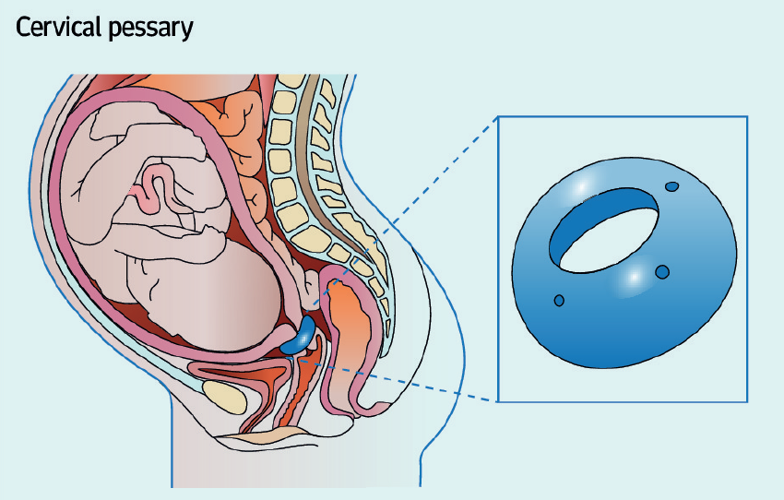
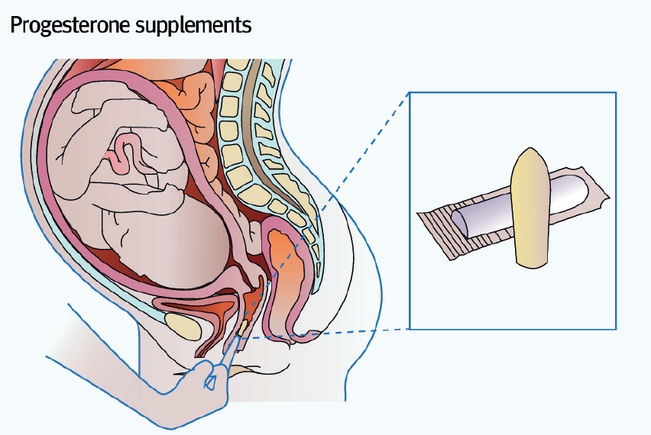
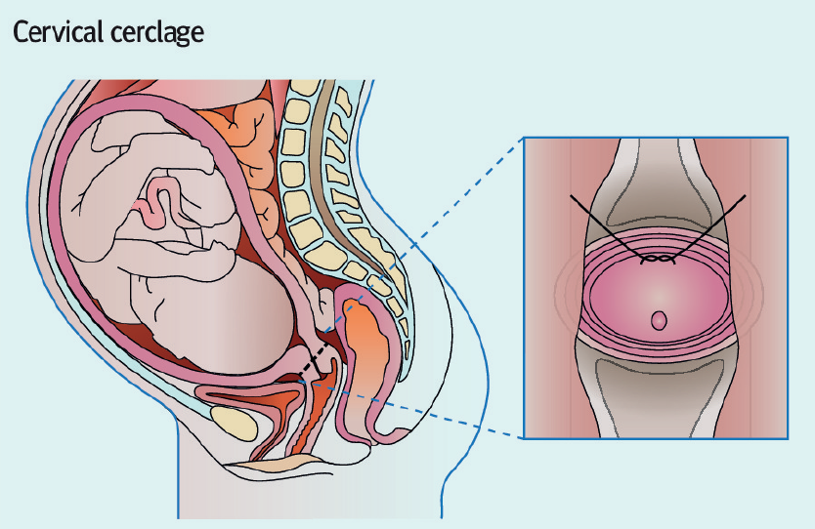
Interventions for PTB
Arabin Pessary
Progesterone
Cerclage

Slide 7
Vaginal Progesterone

Slide 8
Vaginal Progesterone
Protocol
Intravaginal - UK.
One pessary daily
Started between 16-22 weeks.
Stopped at 34-36 weeks.
NICE recommends offering vaginal progesterone to
singleton pregnancy + Clinical Risk AND/OR Short Cx

Slide 9
Vaginal Progesterone
Evidence
IPD and SR meta-analyses
Support the use of progesterone
Driven by one RCT¹
Universal screening using cut off 10-20 mm
OPPTIMUM²: No effect on
PTB, NND, severe morbidity or neurodevelopment
Singleton
IPD meta-analysis – no benefit (1735 women)
Potential benefit if short cx (116 women)
Multiple
1. Hassan SS et al. Int. Soc. of Ult. in Obs. and Gynecol. 2011, doi:10.1002/uog.9017.
2. Norman JE et al. The OPPTIMUM study. Lancet 2016;387:2106-16. pmid:26921136.

Slide 10
Cervical Cerclage

Slide 11
Cervical Cerclage
Protocol
Purse string suture.
strengthen or tighten!?
Inserted between 12-24 weeks.
Removed at 37 weeks.
Mersilene tape (Multi-fillament)

Slide 12
Cervical Cerclage
Evidence
IPD and SR meta-analyses
Delayed gestational age at delivery
reduced PTB in women at risk
No difference in perinatal outcomes
IPD analysis of <25mm
reduction in composite neonatal morbidity
Singleton
SR meta-analysis – no benefit (128 women)
No firm conclusions harms
Multiple
NICE recommends offering cerclage to
singleton pregnancy + Clinical Risk + Short Cx

Slide 13
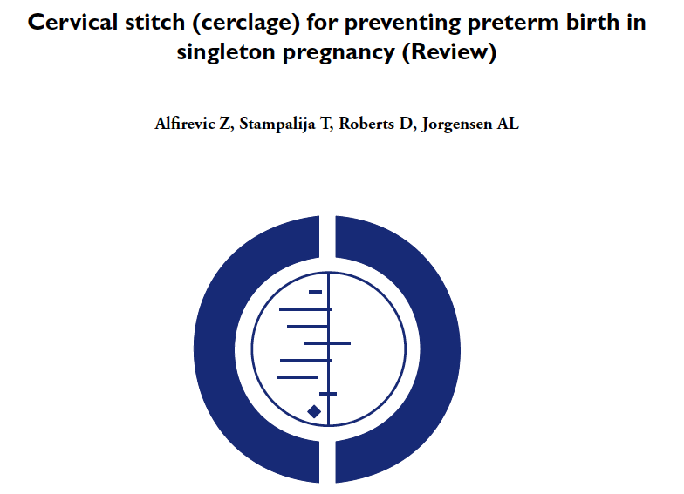

Slide 14
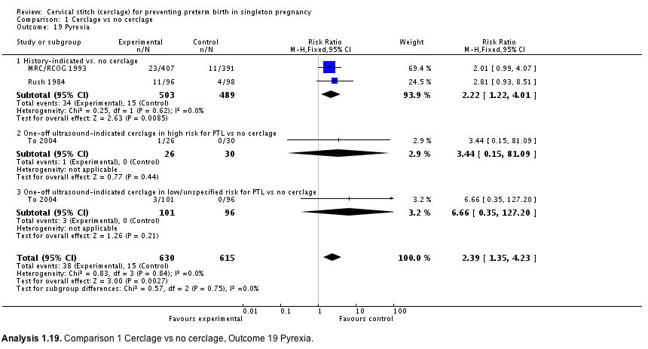
Cervical Cerclage
Infection
Alfirevic Z, et al, Cochrane review

Slide 15
Cervical Cerclage
Infection
Cerclage was associated with:
vaginal discharge
bleeding
pyrexia
Pyrexia - a particular problem, with 3 RCTS
6% versus 2.4% (RR 2.39).

Slide 16
Cervical Cerclage
Suture
Braided / multifilament
Monofilament
Traditionally
Strong
Easy to remove
Doesn’t cut through the tissues
Low risk of infection
Easy to insert
Cheese wire effect

Slide 17
Cervical Cerclage
Suture
National survey: UK Consultants
75% stated there is no guidance for a particular suture material in their unit
14%) uses a monofilament suture suture
28% not sure what is the best suture material

Slide 18
Cervical Cerclage
Infection
Non absorbable meshes are associated with significant risk of infection.
Abandoned in ophtalmology.
Infection is associated with cerclage
Infection is a cause of PTB
No RCTs of braided vs non-braided sutures

Slide 19
Cervical Cerclage
Suture
Systematic review: Non-Randomised Studies

Slide 20
Research Hypothesis
The unrealised benefit of cervical cerclage is, at least in part, due to the type of suture material used.
Cerclage Suture Type for an Insufficient Cervix and its effect on Health (C-STICH)
ISRCTN15373349

Slide 21
Cervical Pessary
(Arabin)

Slide 22
Vaginal Progesterone
Protocol
Silicon ring sits below Cervix.
Support and tilt posteriorly
Inserted between 18-22 weeks.
Removed at 37 weeks.
Not reviewed by NICE

Slide 23
Vaginal Progesterone
Evidence
2 RCTs (several hundred women)
Short cervix on TVS
Arabin versus expectant management
The smaller trial reported a benefit¹
The larger trial found no benefit²
Singleton
2 RCTs (twin pregnancies)
No other risk factors for PTB
No difference between cervical pessary and routine care.
3rd RCT (Multiple pregnancy + short Cx)
Reduction in PTB with a cervical pessary.
Multiple

Slide 24
Ongoing Trials
Name | Population | Intervention | Comparator
C-STICH | Singleton + Indication for cerclage | Monofilament | Mersilene
MAVRIC | Singleton + Failed Vaginal Cerclage | Abdominal cerclage | High or low vaginal
ReCAP | Singleton + Short Cervix | Cerclage | Progesterone or Arabin
STOPPIT 2 | Multiple + Short Cx | Arabin | Standard care
SuPPoRT | Singleton + Short Cervix | Cerclage | Progesterone or Arabin

Slide 25
Conclusions:
Reduction in early PTB ≠ improved health in children.
Cervical cerclage:
Women at clinical risk + short cervix.
Progesterone:
Women with short cervix − risks.
Cervical Pessary:
Further evidence for out of a research setting.
Multiple pregnancy:
Treatments only in the context of clinical trials.

Slide 26
Acknowledgement
Dr Sarah Stock
COTS and C-STICH teams

Slide 27
Thank you
Notes:
27
Our business presents:
Clear innovation
True mechanism for profit
Unique opportunity to make medical history
A chance to make a significant impact on women and children world-wide
We are about:
Meeting peoples needs
Meeting the needs of the market place
Meeting the needs of the mother and her unborn child.
We as a team are not afraid…
… Achieving certainty

Slide 28
Antibiotics for PTB
Evidence
RCTs have given conflicting results
Meta-analyses of studies of ABx to prevent PTB limited by trial heterogeneity.
Small SR suggests that clindamycin treatment before 22/40 in women with BV may reduce PTB at <37 weeks
(Lamont et al, 2011).
Subsequent systematic review: No reduction in PTB with ABx for BV
(Brocklehurst et al 2013)
A 7-year follow-up of a large RCT: Increased CP in children born to mothers
treated with antibiotics during an episode of suspected spontaneous preterm labour.
(Kenyon et al 2008)
Not reviewed by NICE

